Slide 1
Agenda
Welcome | Chris Clarke, Scape Group
An introduction to the programme approach structure and content | Class of Your Own
Accreditation on completion | Industrial Cadets / EDT
Key Resources for schools and Students | Class of Your Own
The role of the school lead/mentor | Class of Your Own
An introduction and demonstration of the Learn Live platform | TBC LL
Q&A | All

Slide 2
WELCOME!

Slide 3
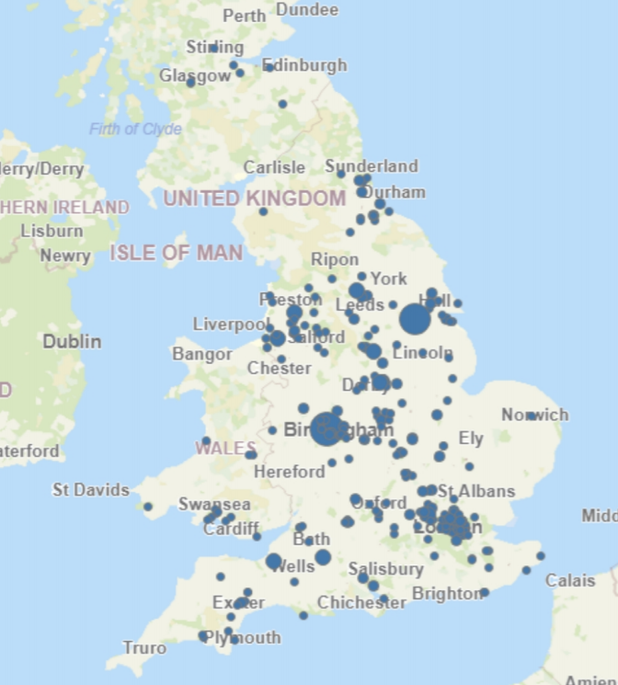
Agenda
March…
Now…

Slide 4
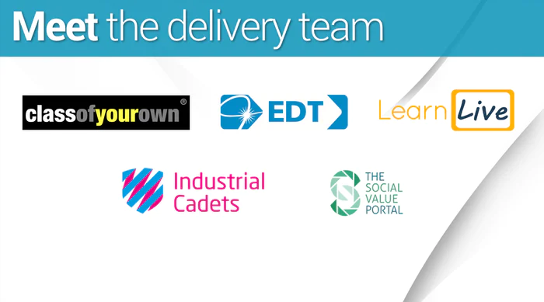
Agenda

Slide 5
HOW IT WORKS

Slide 6
Participants starting point, this document outlines the design brief for the teams and includes information regarding the use of the building, the site location, size of site and deliverables.

Slide 7
Work Experience Student Guide
An outline of the week including a timetable of activities and objectives and hints and tips for students.

Slide 13
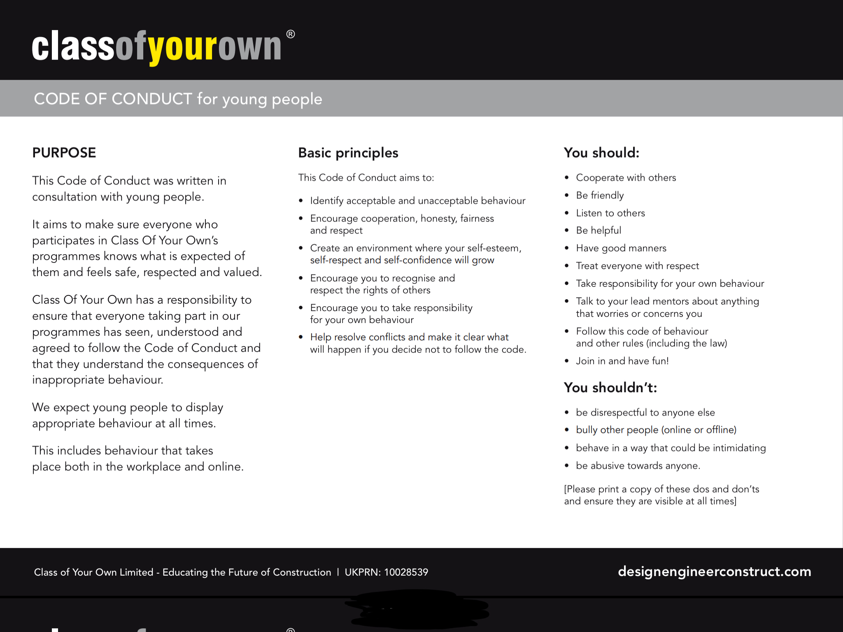
Code of Conduct
This Code aims to make sure everyone who participates in the work experience programmes knows what is expected of
them and feels safe, respected and valued. It outlines the behaviour we expect young people to display at all times.

Slide 14
School Guidance
Your starting point, this document outlines the design brief for the teams and includes information regarding the use of the building, the site location, size of site and deliverables.

Slide 15
FAQs for schools
Frequently Asked Questions to help schools plan and get the most out of the work experience week.

Slide 16
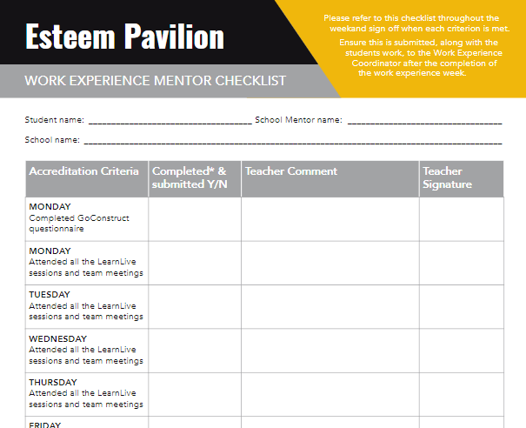
School mentor checklist
A summary of the week’s objectives and end point deliverables required for moderation leading to Industrial Cadet Silver Award accreditation.

Slide 17
Accreditation on completion
This fantastic week is being accredited by Industrial Cadets at Silver level.
Industrial Cadets is an industry led accreditation for work related experiences and challenges inspired by our Patron HRH The Prince of Wales, designed to create a skilled and motivated workforce with strong links and influences from industry partners.
This is an industry recognised award and a great addition to their CV.
Students who have completed all aspects of the challenge will be awarded a Silver Industrial Cadets award. This includes a certificate and digital badge.
Moderation and evaluation of completed work by our QA team
Young people become part of the Industrial Cadets network, and gain access to further career opportunities through, EDT, partners and industry.

